Slide 1

Embedded web server
NC_09
SANJANA R CHANDRAGIRI
OM SHANKAR SAH

Slide 2
ABSTRACT: The embedded web server technology is the mixture of embedded device and internet era, which offers a flexible remote tool monitoring and control function based totally on internet browser and it has become an advanced development fashion of embedded generation. thru this embedded web server person can get entry to their equipment remotely. The equipment noted here will be domestic home equipment and manufacturing facility devices. This paper is targeted on awareness of TCP/IP suite and user improvement platform for this embedded net server. The embedded web server layout consists of a complete internet server with TCP/IP aid and Ethernet interface. it also includes guide for sending mail, and software for computerized configuration of the web server inside the network. The web server reference design consists of complete supply code written in C-language. key words: domestic home equipment, computerized configuration.

Slide 3
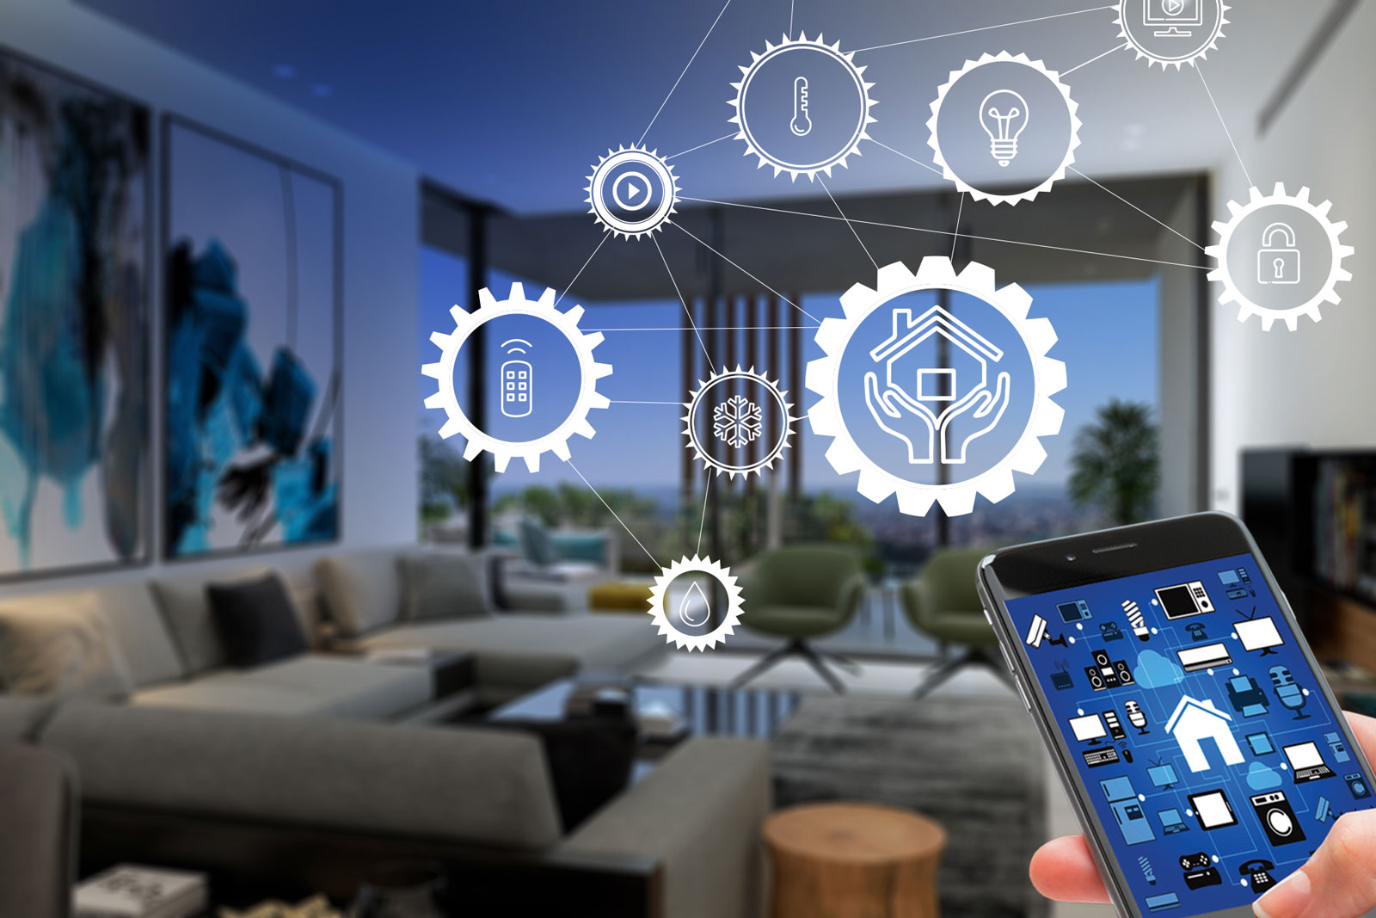
INTRODUCTION::
The Embedded systems marketplace is the most conservative.
Intelligent homes will be connected to the Internet and requires a microcontroller to communicate with the other network devices.
Recently, ubiquitous computing technology and home network technology have developed rapidly and are in practical use.
Therefore, more and more convertibility to the Internet will be required for home appliance such as lighting fixtures, refrigerators and audio-visual equipment.
When these appliances are fitted with servers which are connectable to the WWW, interactive communication will become possible and new functions and services will become available.
The embedded web server can simplify the design process for embedded web server applications.
There has been exponential growth of Internet use in recent years. This has generated a strong trend toward using Internet protocols.

Slide 4
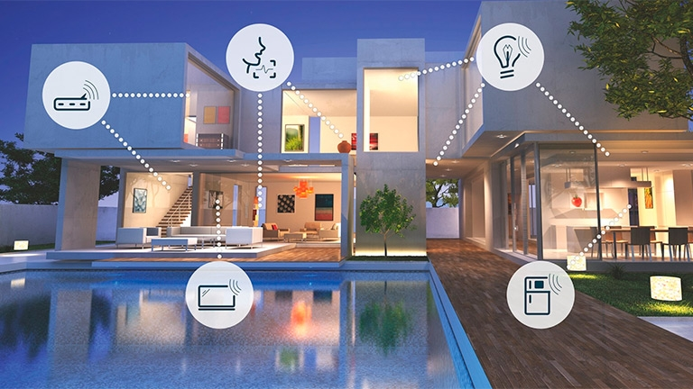
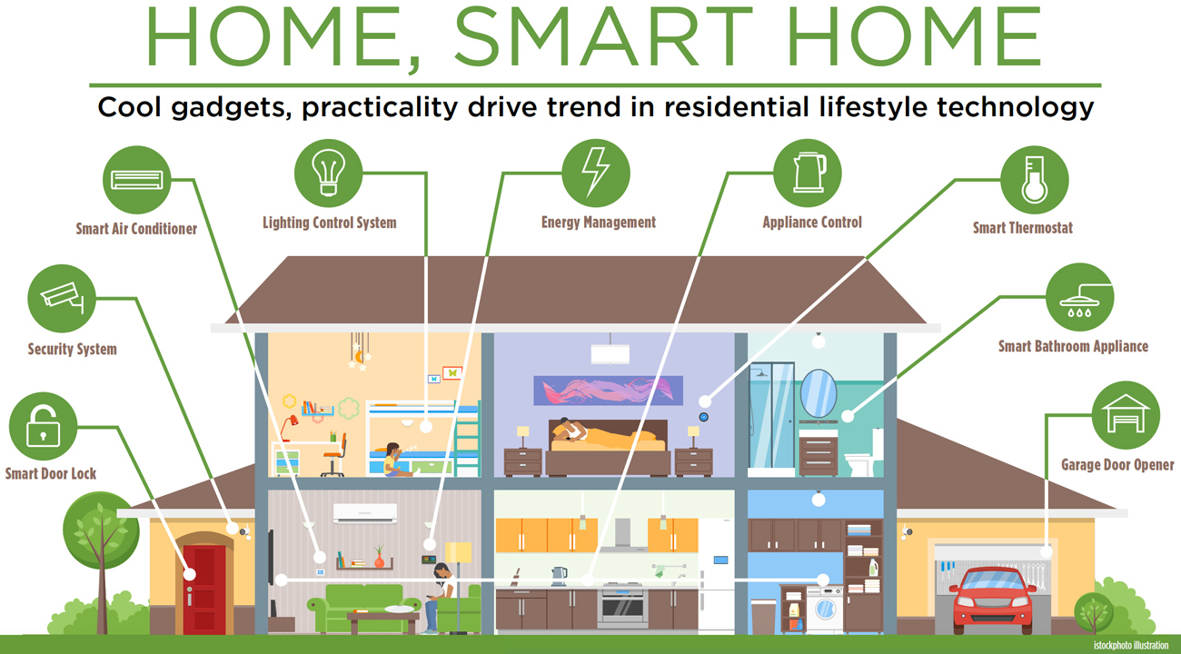

Slide 5
SOFTWARE:
The software running on the embedded web server follows the same layered structure as used in the TCP/IP protocol suite.
The TCP/IP protocol suite allows computers of all sizes, running different operating systems, to communicate with each other.
It forms the basis for what is called the worldwide Internet; a Wide Area Network (WAN) of several million computers.
The TCP/IP protocol suite is a combination of different protocols at various layers
Every layer acts independently from each other.
An Ethernet controller driver controls the Ethernet interface.
The Address Resolution Protocol (ARP) translates IP addresses to Ethernet MAC addresses (and vice versa) .
The Internet Protocol (IP) delivers packets to Transmission Control Protocol (TCP), UDP, and Internet Control Message Protocol (ICMP)
The ICMP answers to PING requests and TCP/UDP delivers data to the applications.
The applications can communicate with the transport layer through buffers with data and variables with control information. This section explains how the TCP/IP protocol suite is built up in our approach.

Slide 6
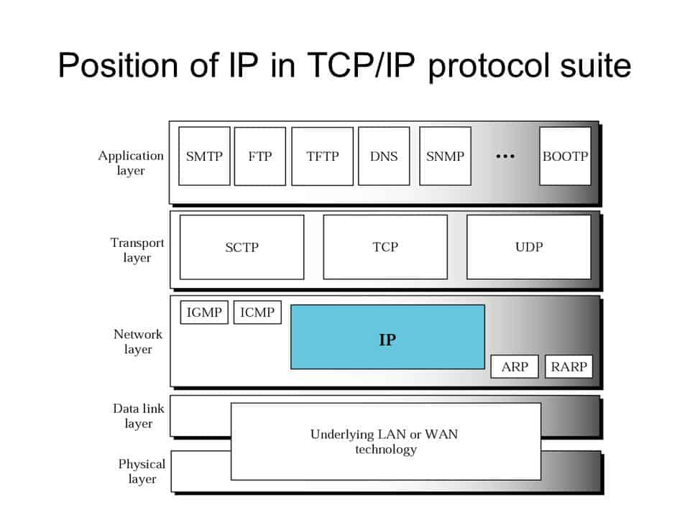
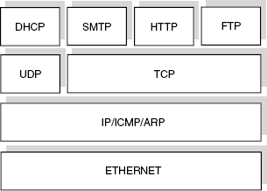

Slide 7
LINK LAYER:
Data-link or Network Interface Layer is another common name of this layer.
The Link Layer normally includes the device driver in the operating system and the corresponding Network interface (card) in the computer.
Together they handle all the hardware details of physically interfacing with the cable.
NETWORK LAYER:
This layer is sometimes called the Internet Layer.
It handles the movements of packets around the network.
Routing of packets, for example, takes place here. IP (Internet Protocol) and ICMP (Internet Control Message Protocol) provides the Network Layer in the TCP/IP Protocol Suite. The network layer controls the communication between hosts on the Ethernet.
There is no form of transmission control to ensure that IP datagrams arrive to the host or that all IP datagrams from another host is received.
This makes the layer rather easy to make. The ICMP sends messages between hosts and is only used to answer PING requests from a host. The IP handles communication for the overlaying Transport Layer.

Slide 8
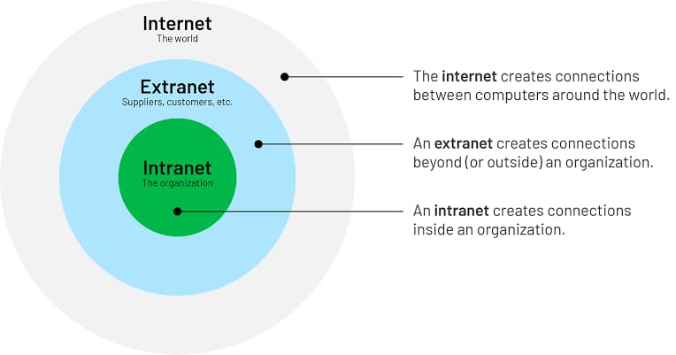

Slide 9
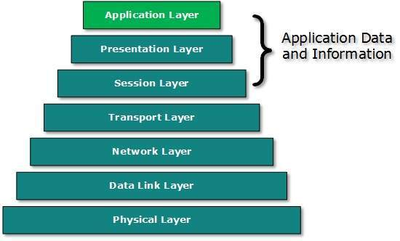
TRANSPORT LAYER:
On the transport layer there are two major protocols which offer two different kinds of service; TCP which is a reliable delivery service and UDP which offers an unreliable service. TCP also offers flow control for retransmission of segments and acknowledgement of received segments.
APPLICATION LAYER:
The Application layer handles the details of a particular application. Several applications may be implemented in the embedded web server. The main limitation is memory usage and performance. Running several applications at once means lower performance.

Slide 10
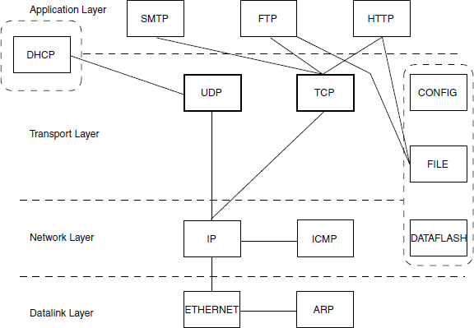
Protocol Dependencies
Figure shows the protocol dependencies for the modules in the Embedded Web server. The protocols are described below:
HTTPD needs TCP and a file system/Data Flash to operate.
FTPD needs TCP and a file-system/Data Flash to operate.
SMTP needs a running TCP implementation to operate.
DHCP needs IP and UDP to operate. In the initialization phase DHCP requires that the IP and UDP protocol forward any IP packets delivered before the IP address is configured.

Slide 11
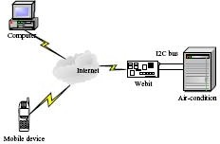
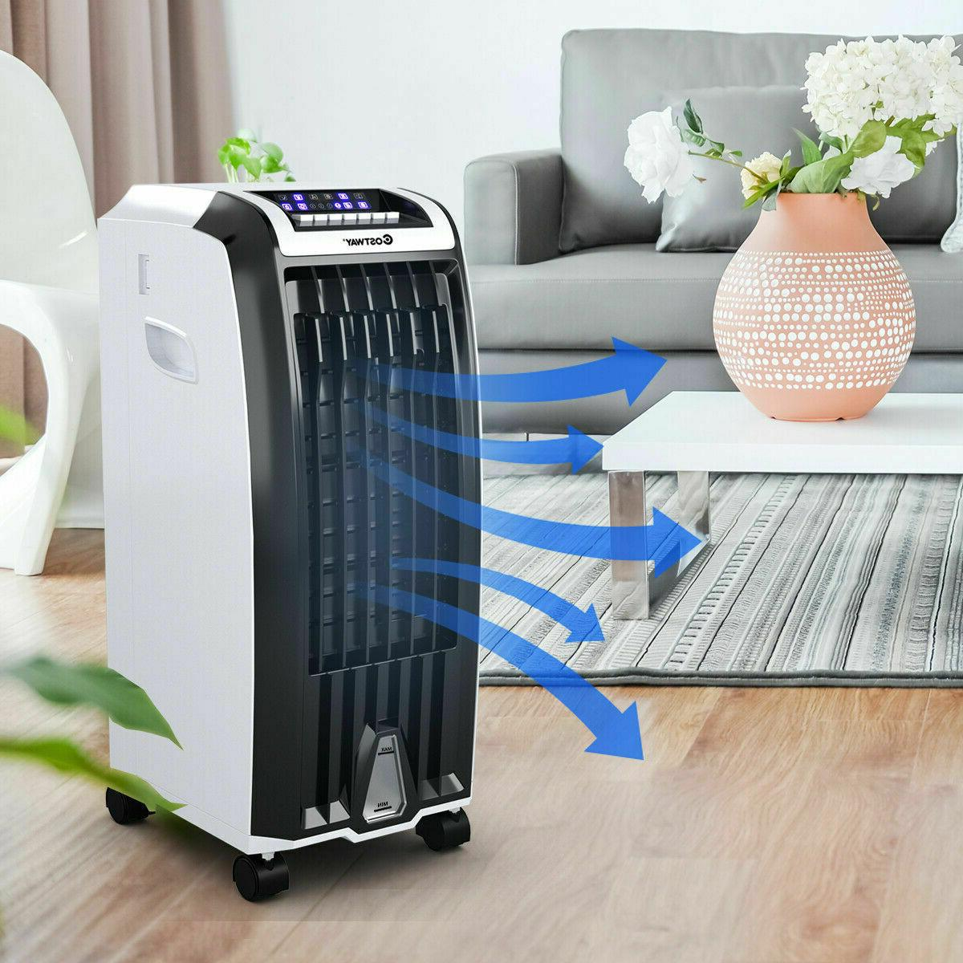
Case Study-The web server apply to a Air Condition

Slide 12
CONCLUSION:
we have delivered the overall design concept of the embedded net server and the coverage of TCP/IP discount, especial the reduction of TCP, whose aim is to permit clean get right of entry to and exploitation of far-flung gadget.
This internet server gives the common devices a web interface and profits a terrific performance.
It is able to be used widely in enterprise, clinical, and other fields, extra essential it may carry us a brand-new domestic existence.
With the web server embedded, we are able to start to see the utility of computing technology in settings wherein they may be unusual these days device and appliance networking in the home; faithful capture of scientific experiments inside the laboratory; and automatic full-time monitoring of affected person.

Slide 13
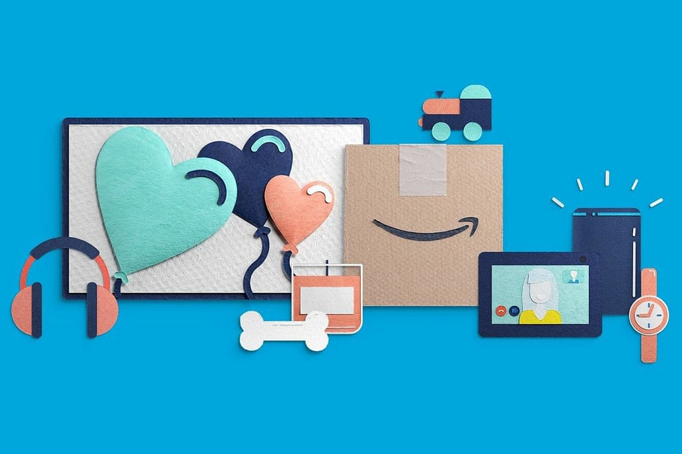
THANK YOU ☺

